Slide 1

init
check-out
commit
branch
add
clone
status
pull
merge
push

Slide 2
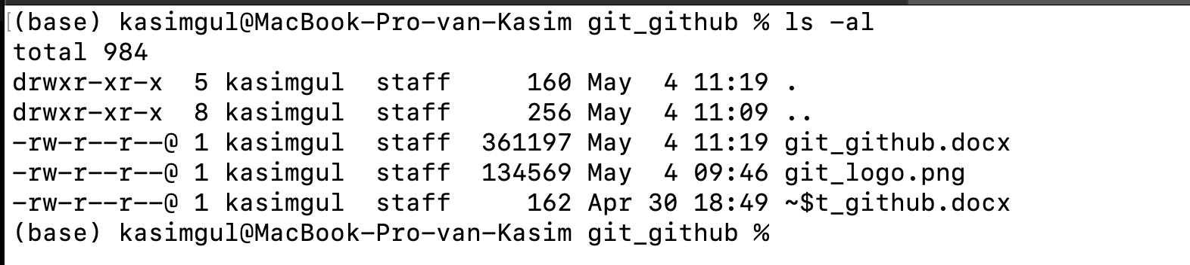
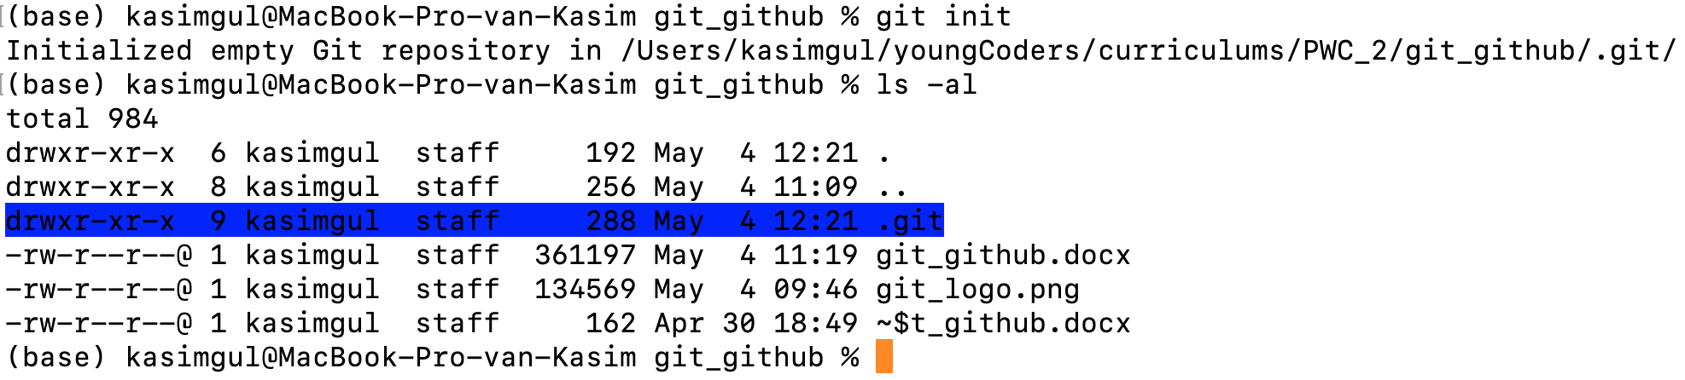

Slide 3
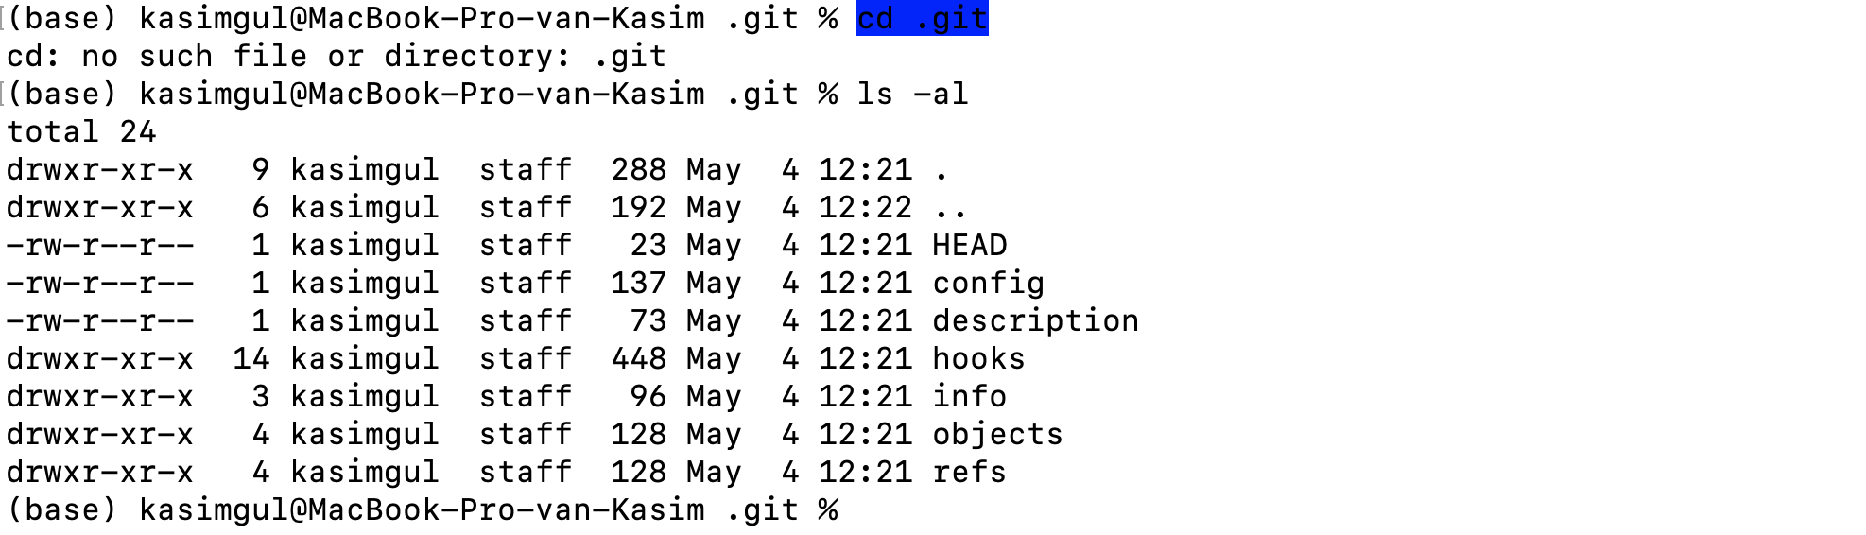

Slide 4
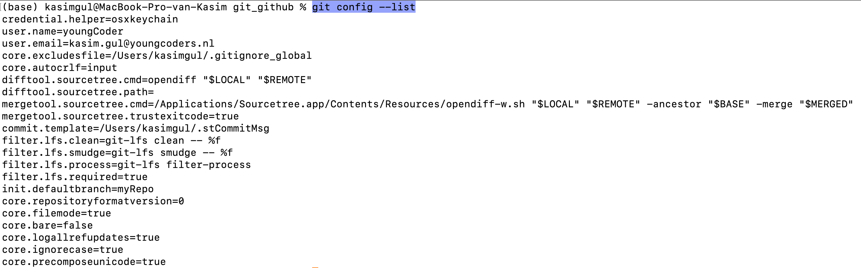
User name
User email
Repository name

Slide 5
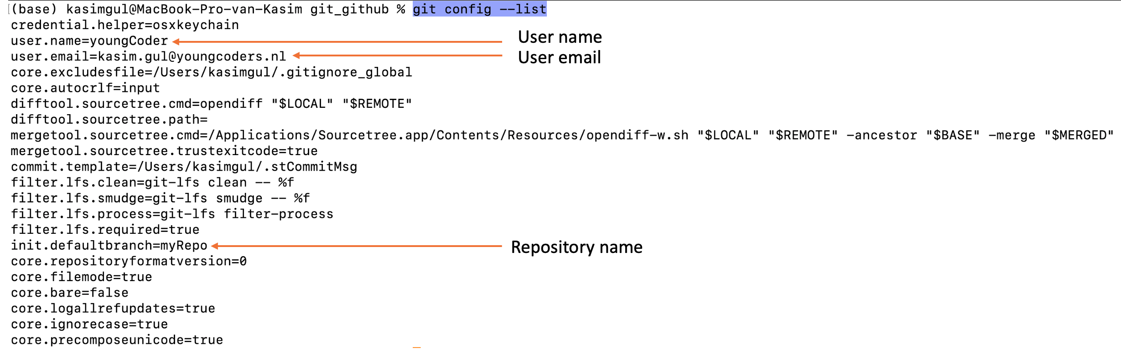
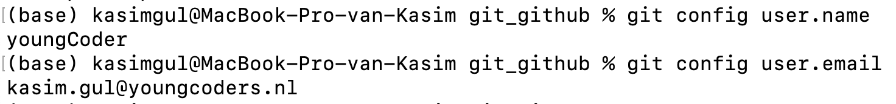

Slide 6
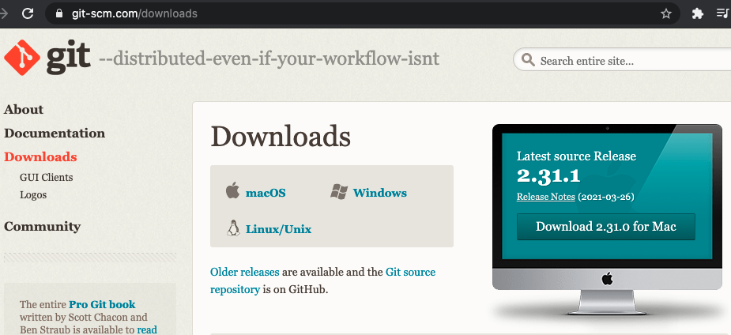

Slide 7
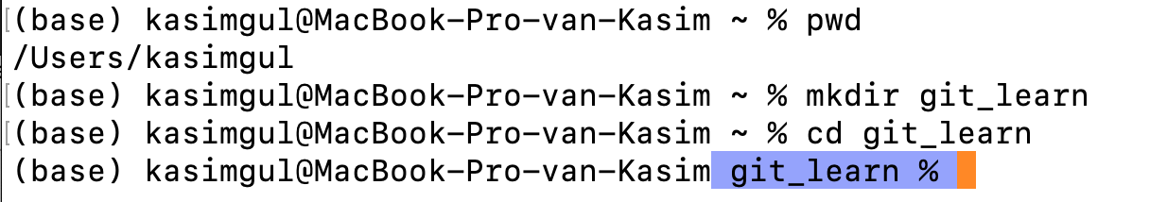
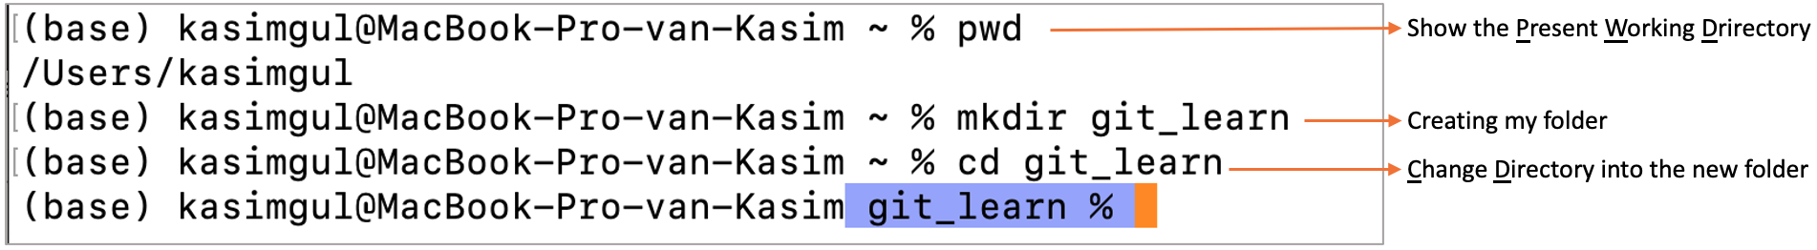
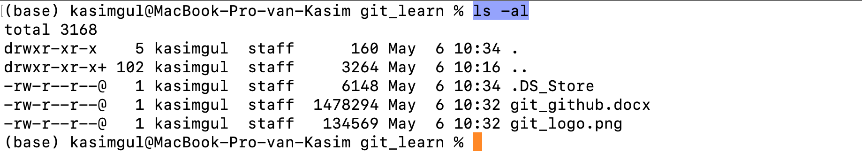
Show the Present Working Drirectory
Creating my folder
Change Directory into the new folder

Slide 8
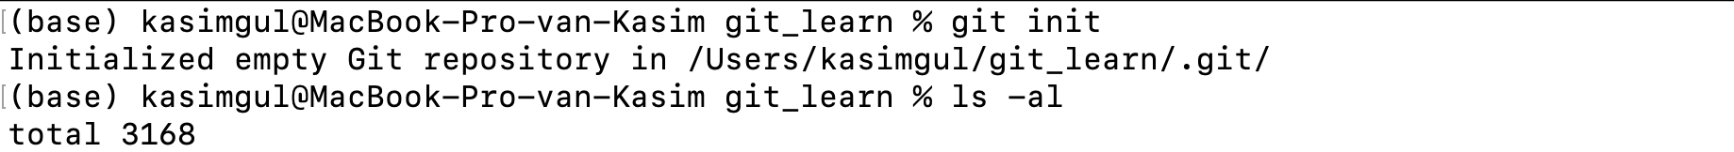
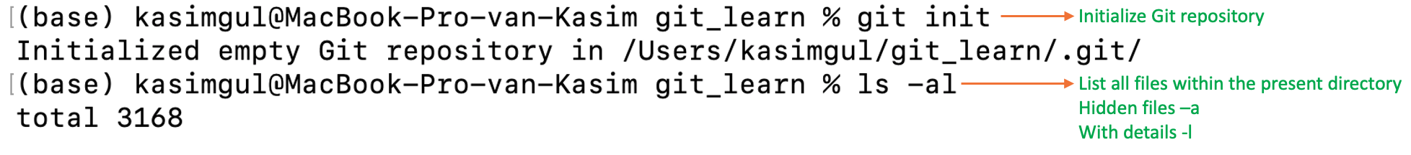
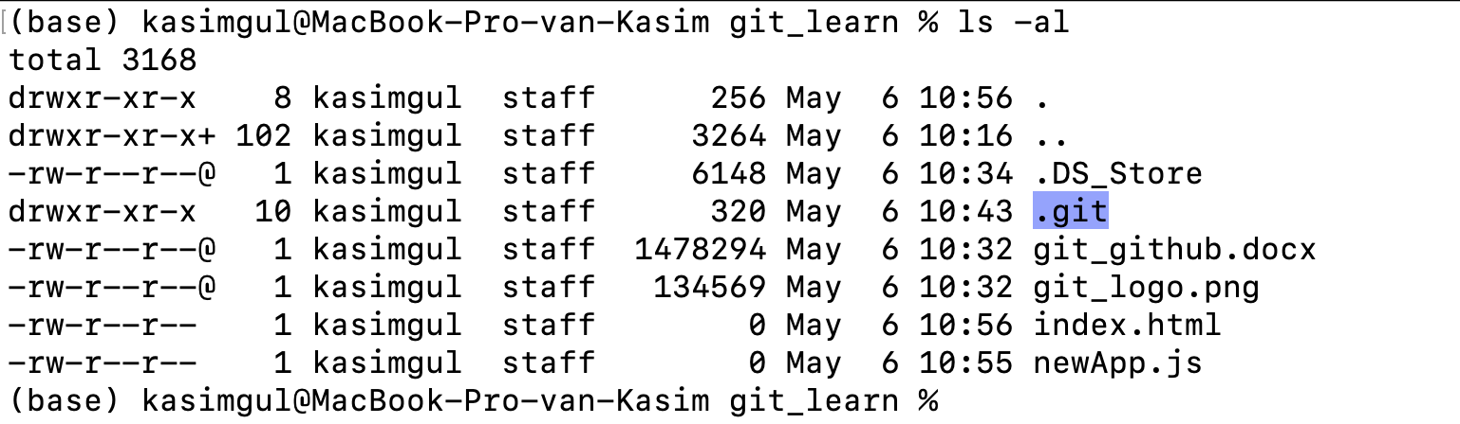
Initialize Git repository
List all files within the present directory
Hidden files –a
With details -l
The Git repository is created

Slide 9
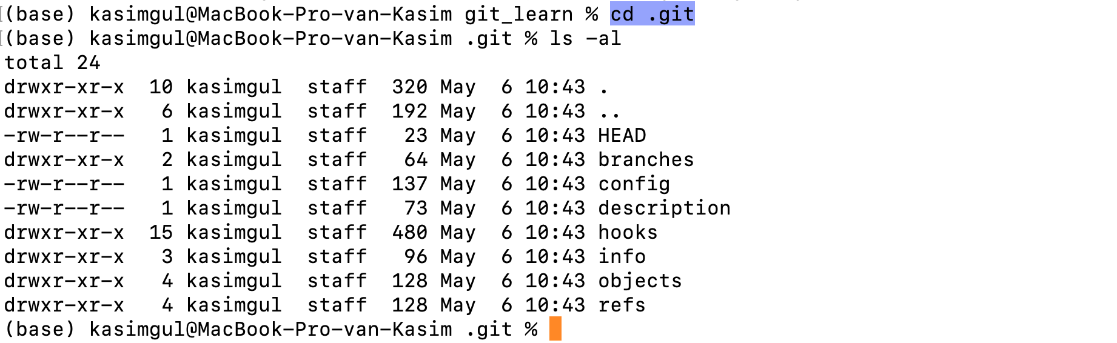

Slide 10
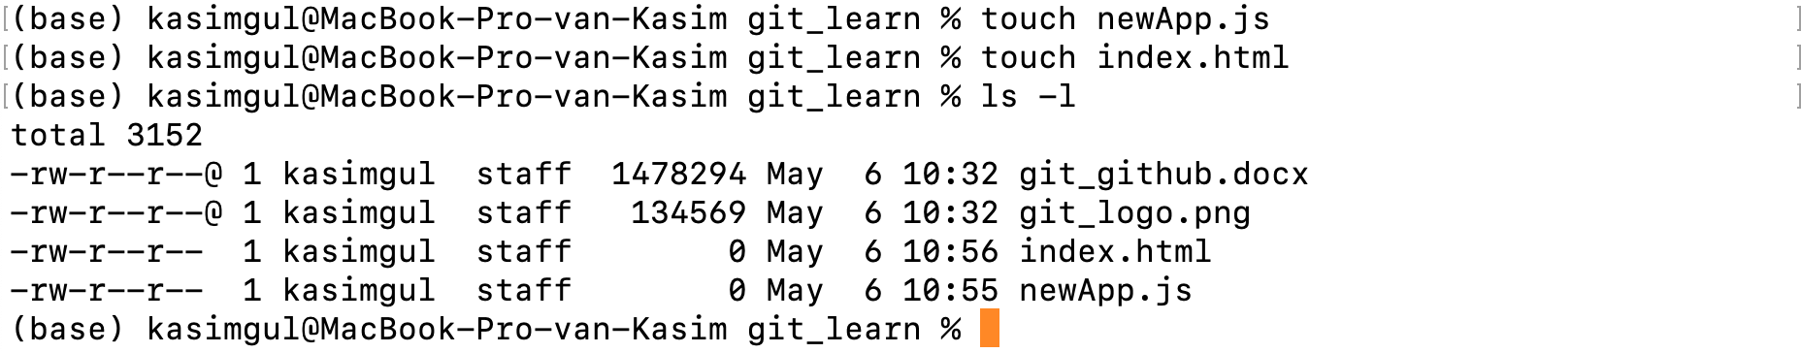
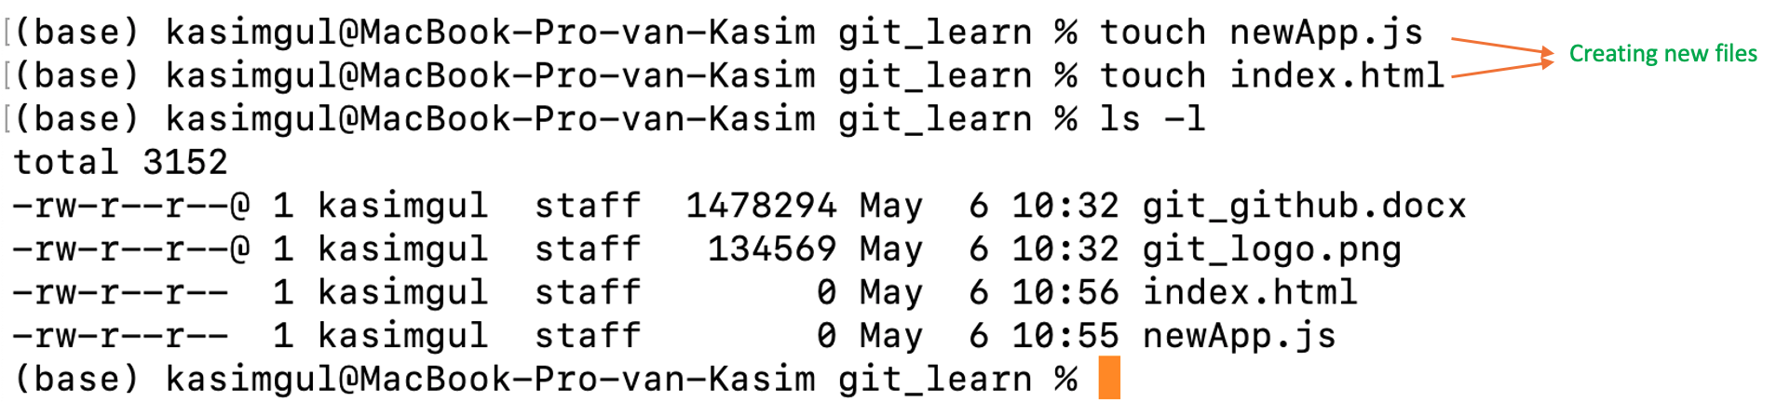
Creating new files

Slide 11
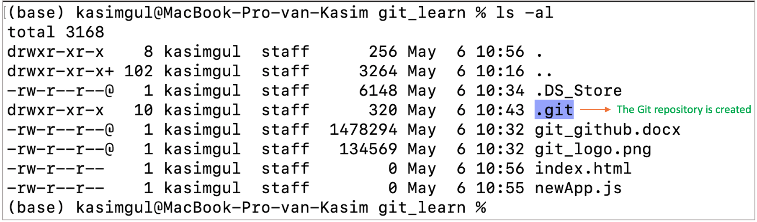

Slide 12
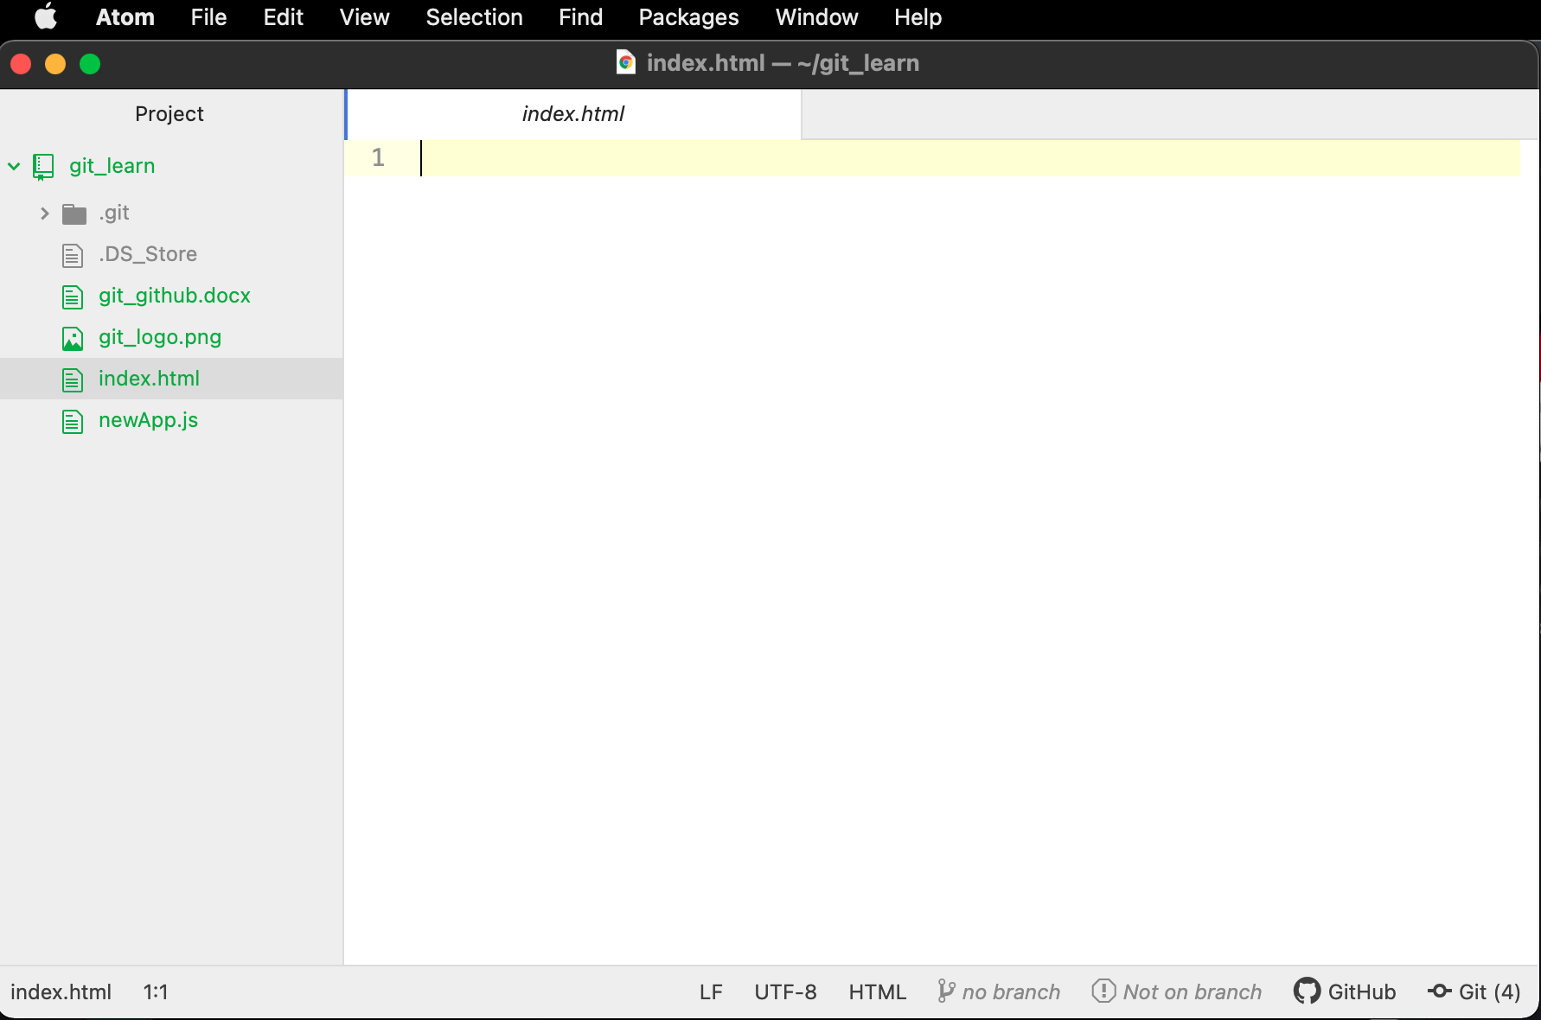

Slide 13
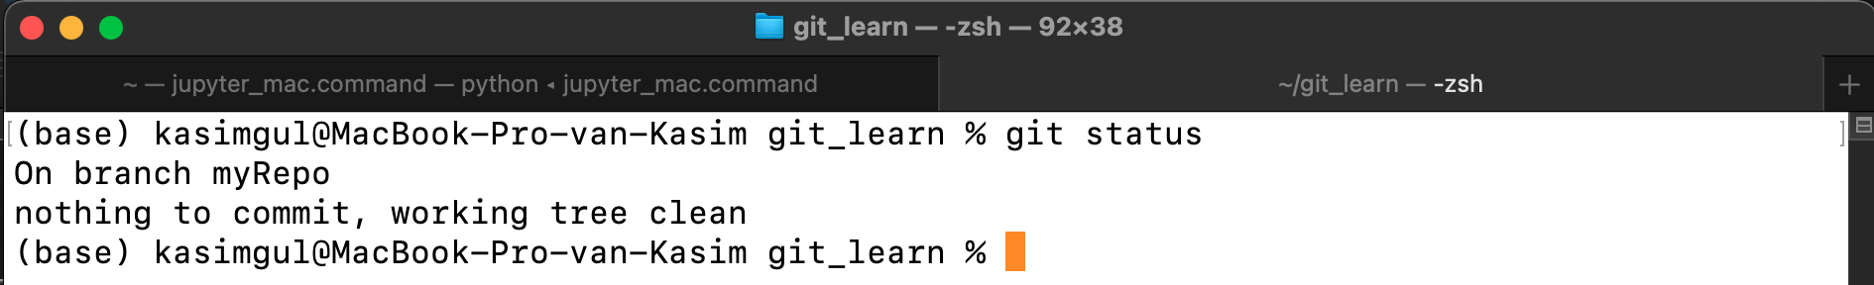
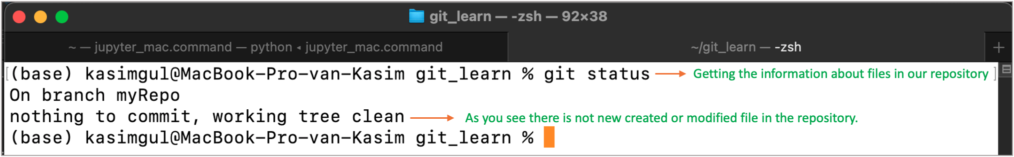
Getting the information about files in our repository
As you see there is not new created or modified file in the repository.

Slide 14
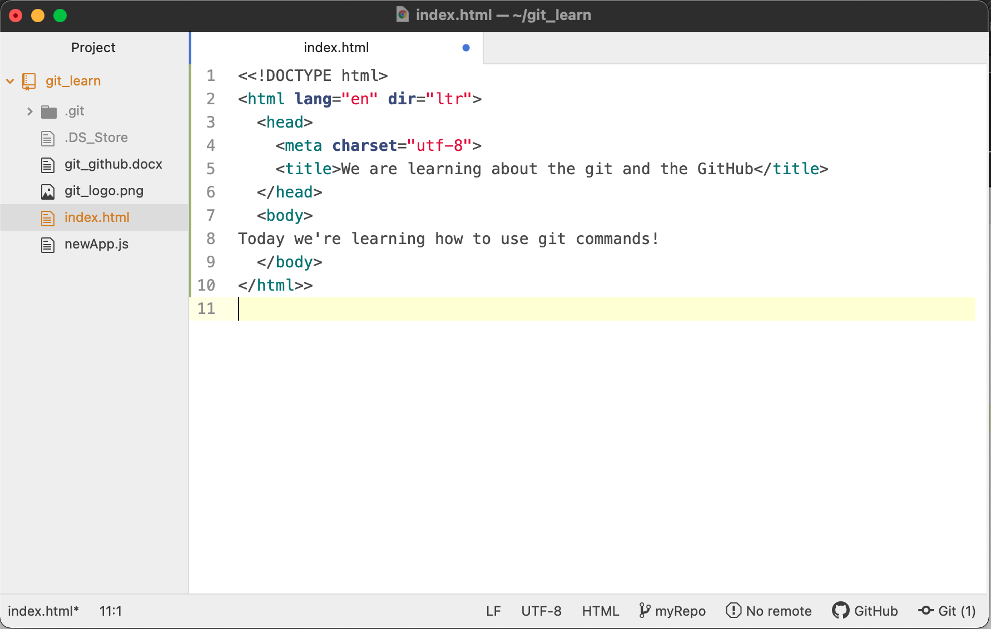

Slide 15
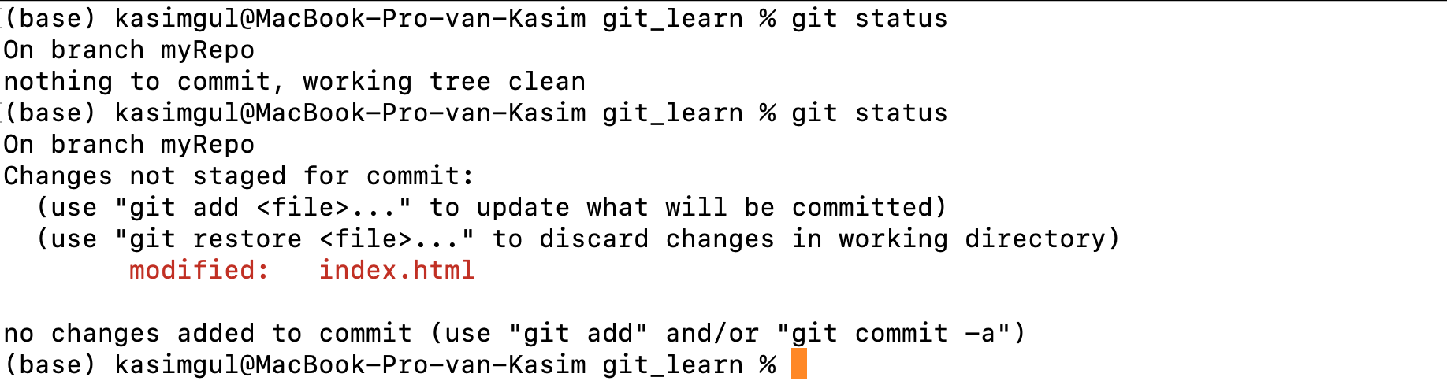
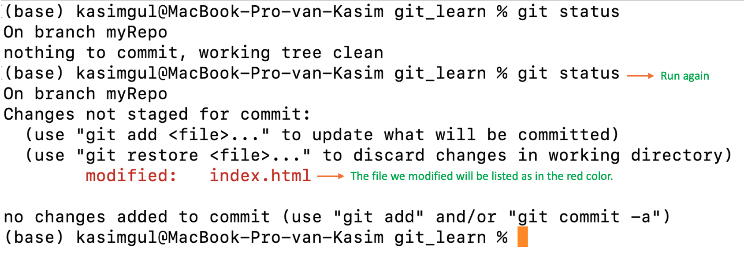
Run again
The file we modified will be listed as in the red color.

Slide 16
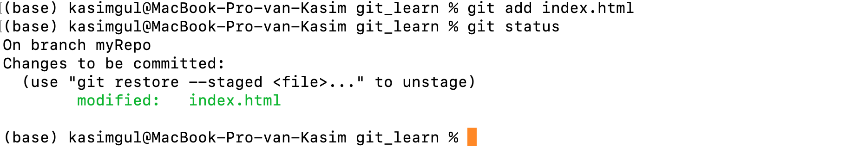
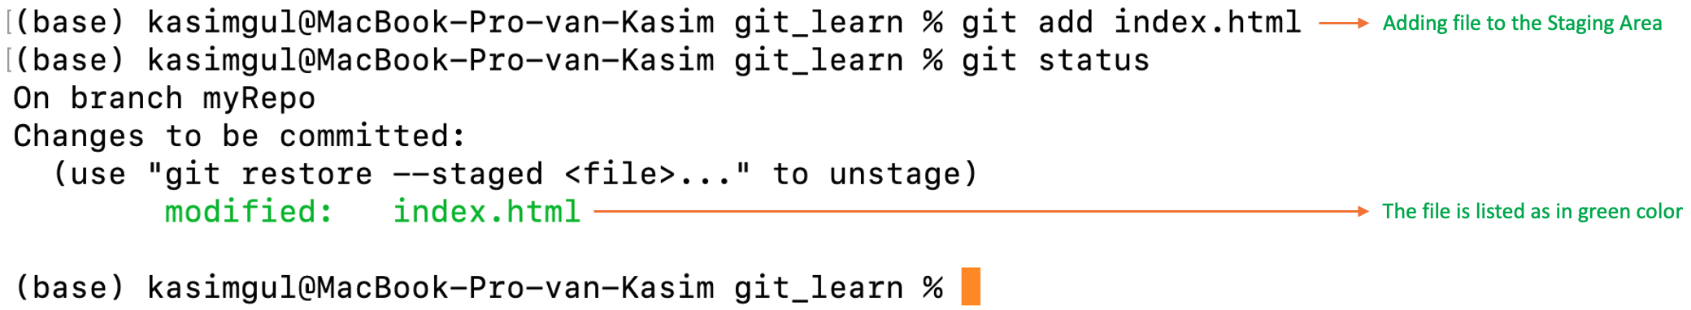
Adding file to the Staging Area
The file is listed as in green color

Slide 17
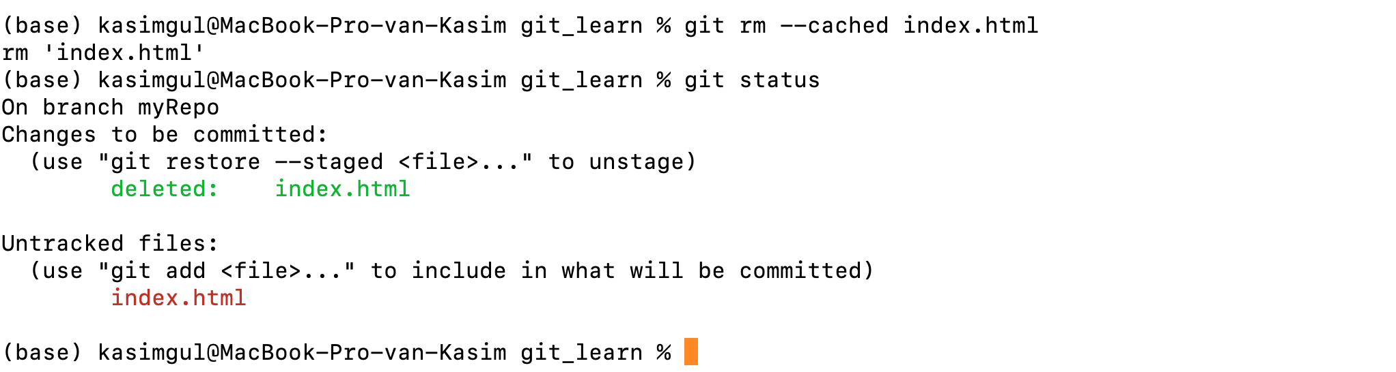
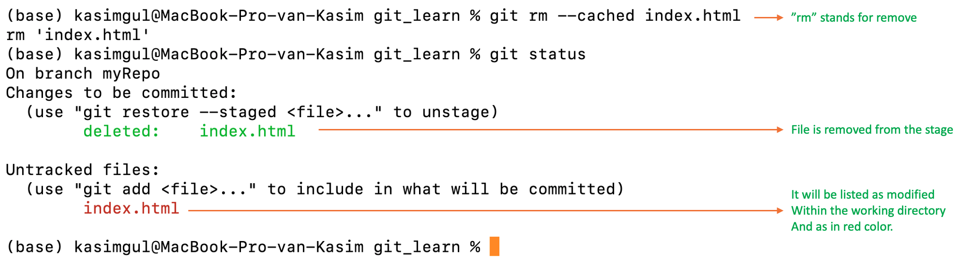
”rm” stands for remove
File is removed from the stage
It will be listed as modified
Within the working directory
And as in red color.

Slide 18
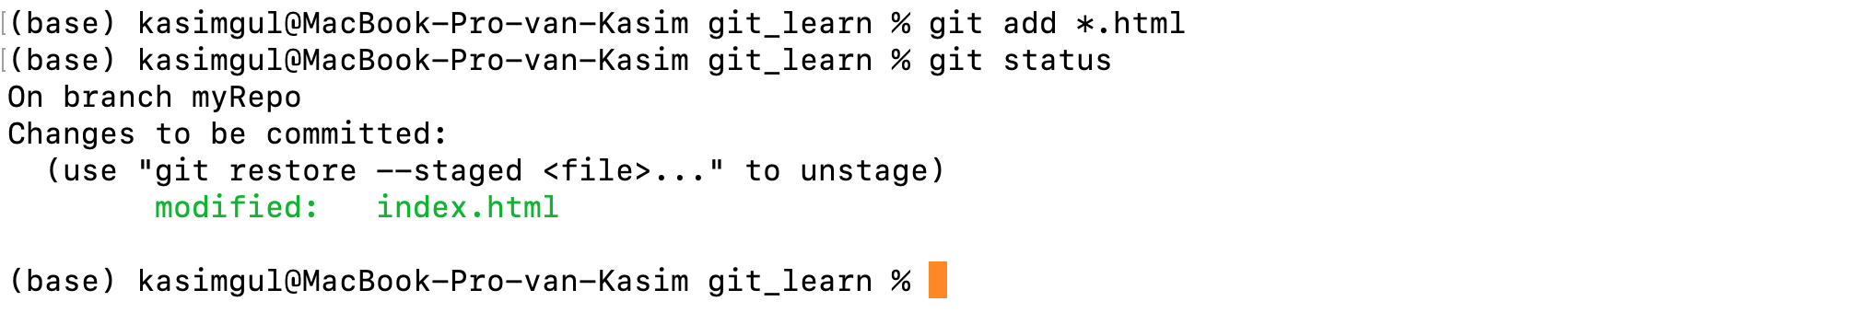
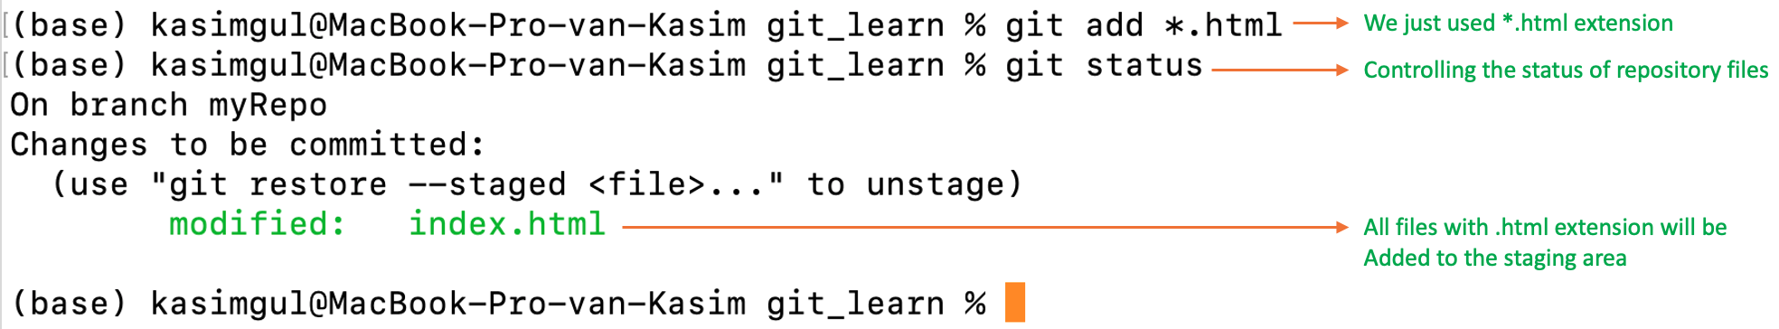
We just used *.html extension
Controlling the status of repository files
All files with .html extension will be
Added to the staging area

Slide 19
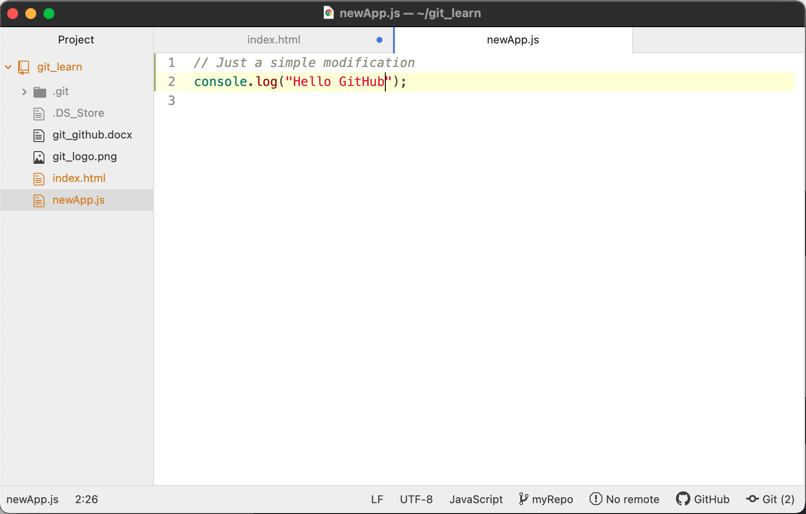

Slide 20
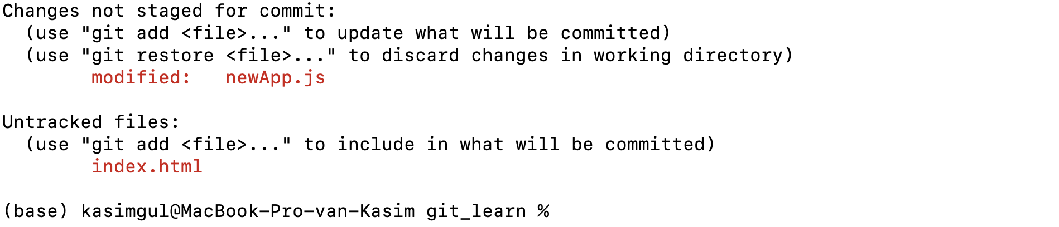
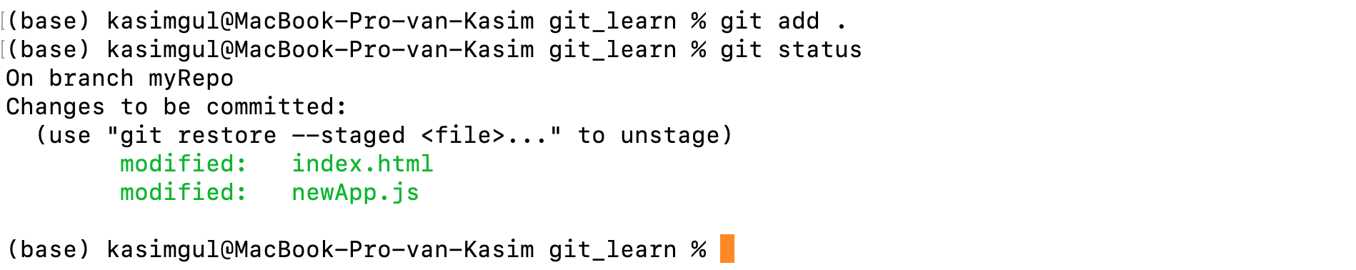

Slide 21
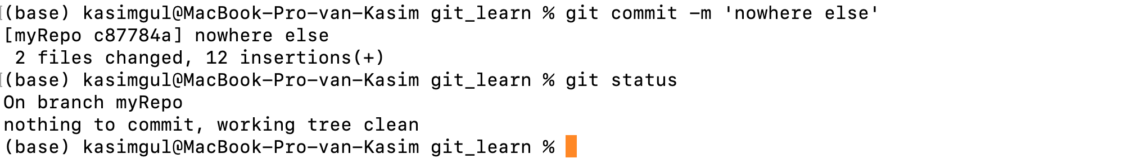
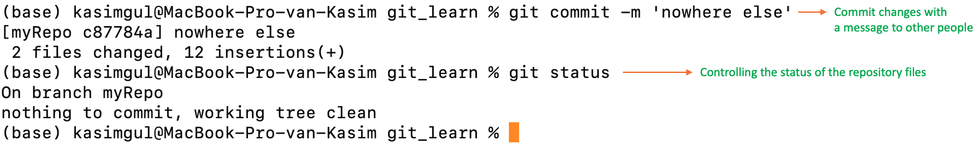
Commit changes with
a message to other people
Controlling the status of the repository files

Slide 22
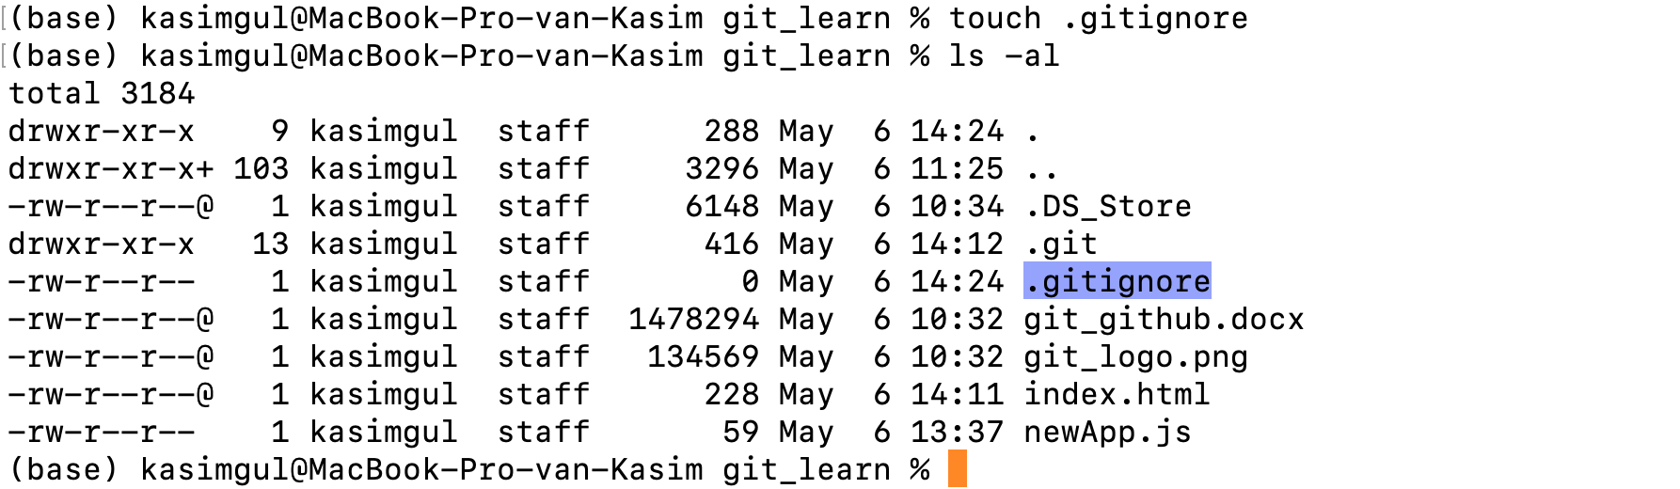

Slide 23
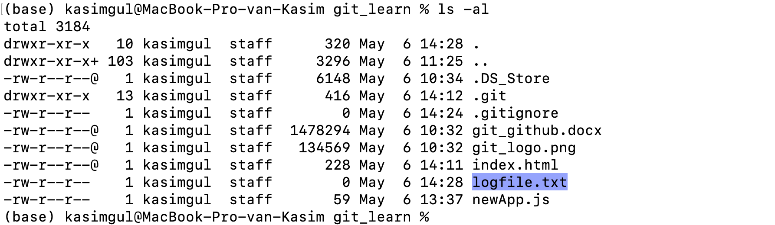

Slide 24
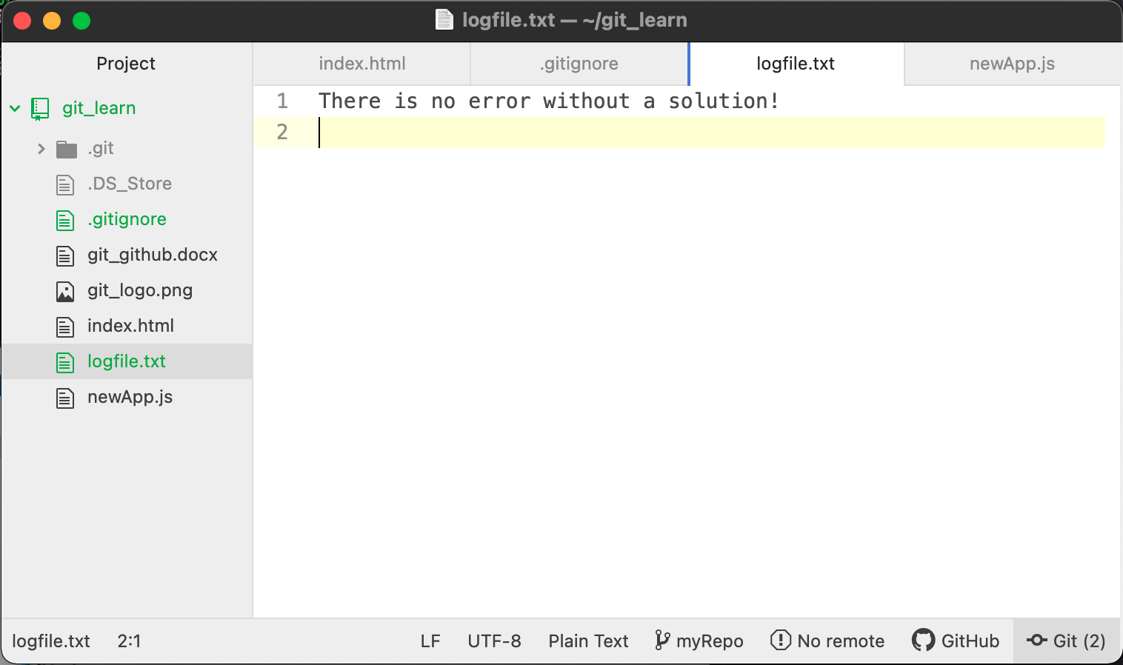

Slide 25
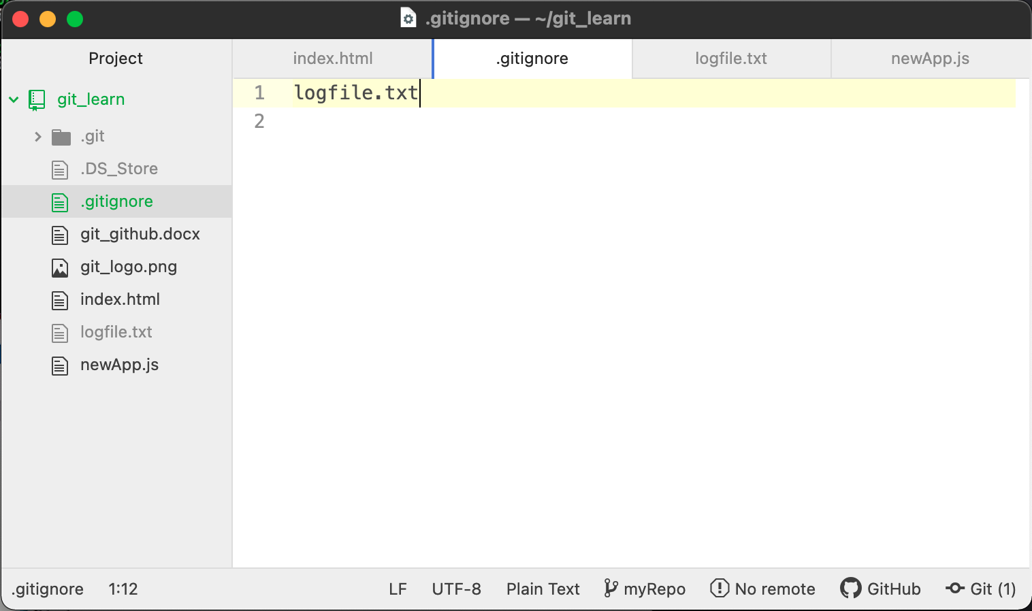

Slide 26
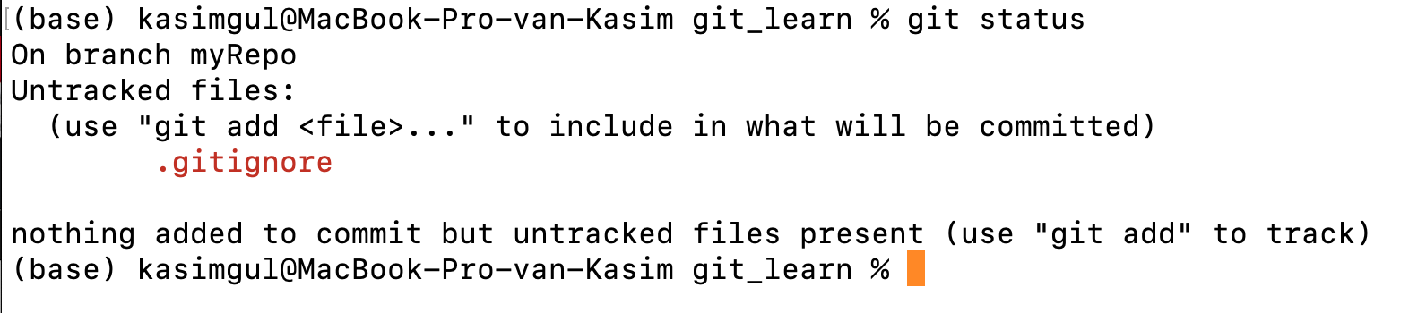

Slide 27
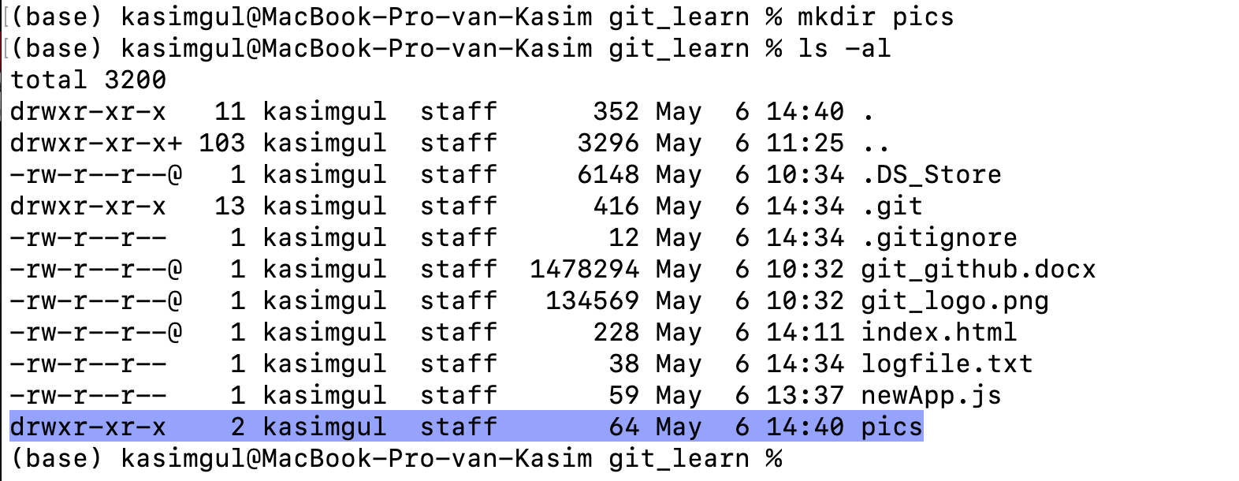

Slide 28
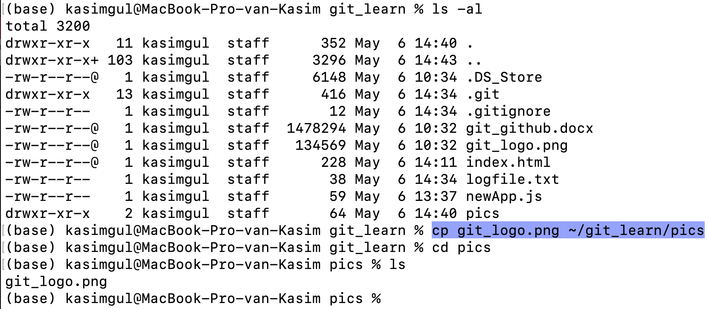

Slide 29
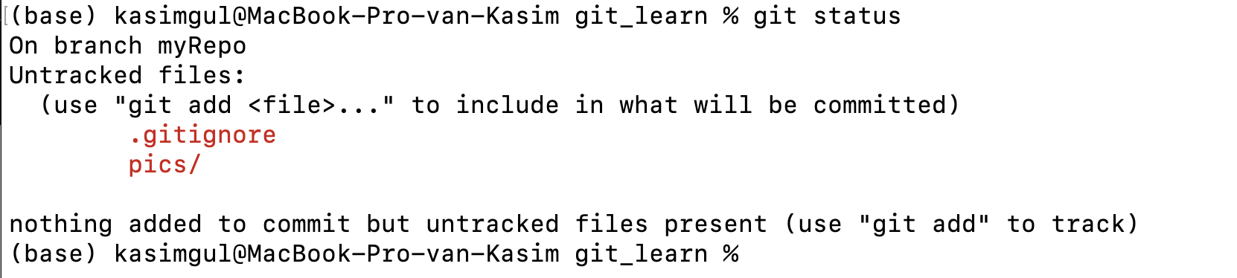

Slide 30
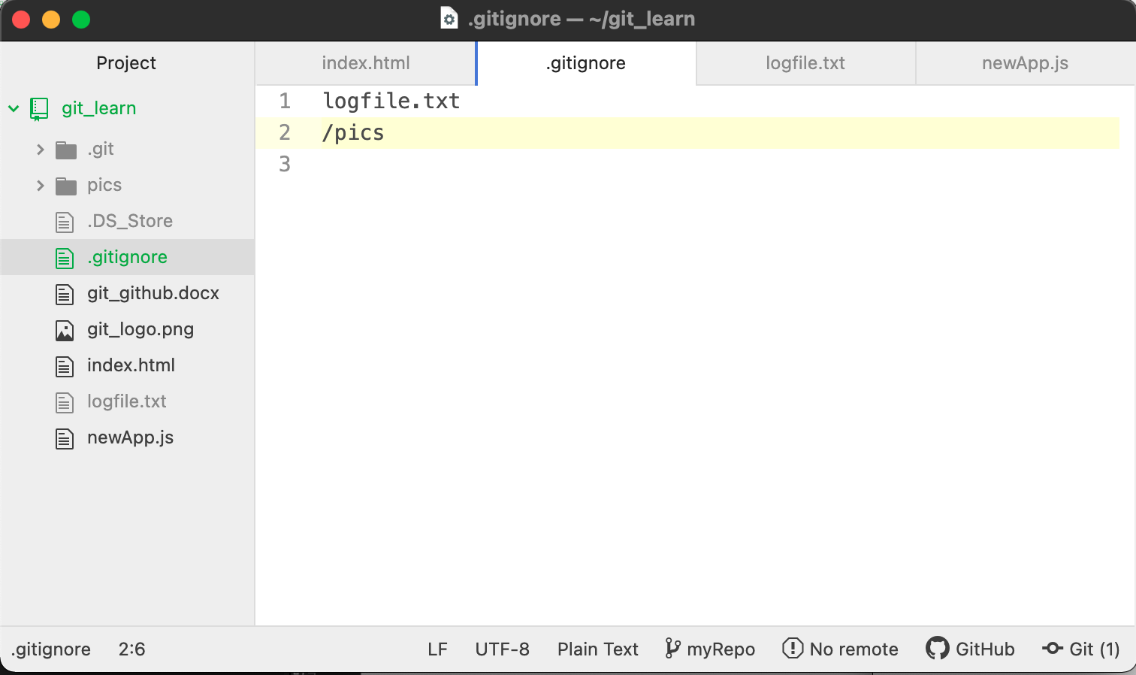

Slide 31
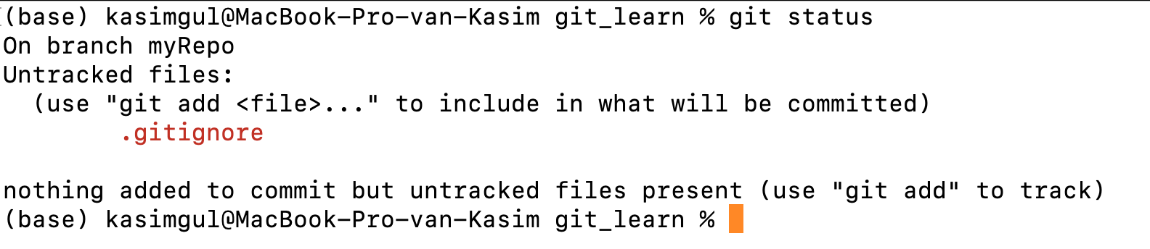

Slide 32
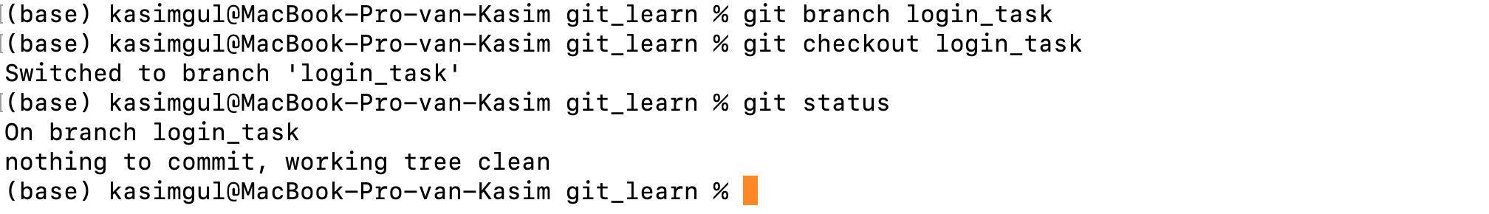
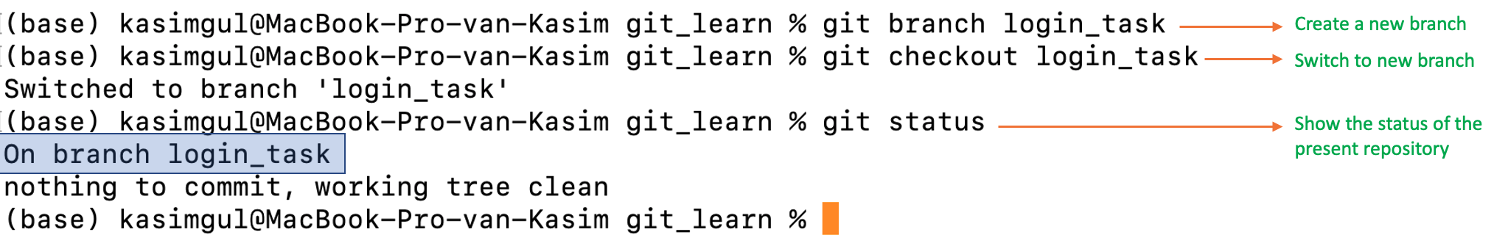
Create a new branch
Switch to new branch
Show the status of the present repository

Slide 33
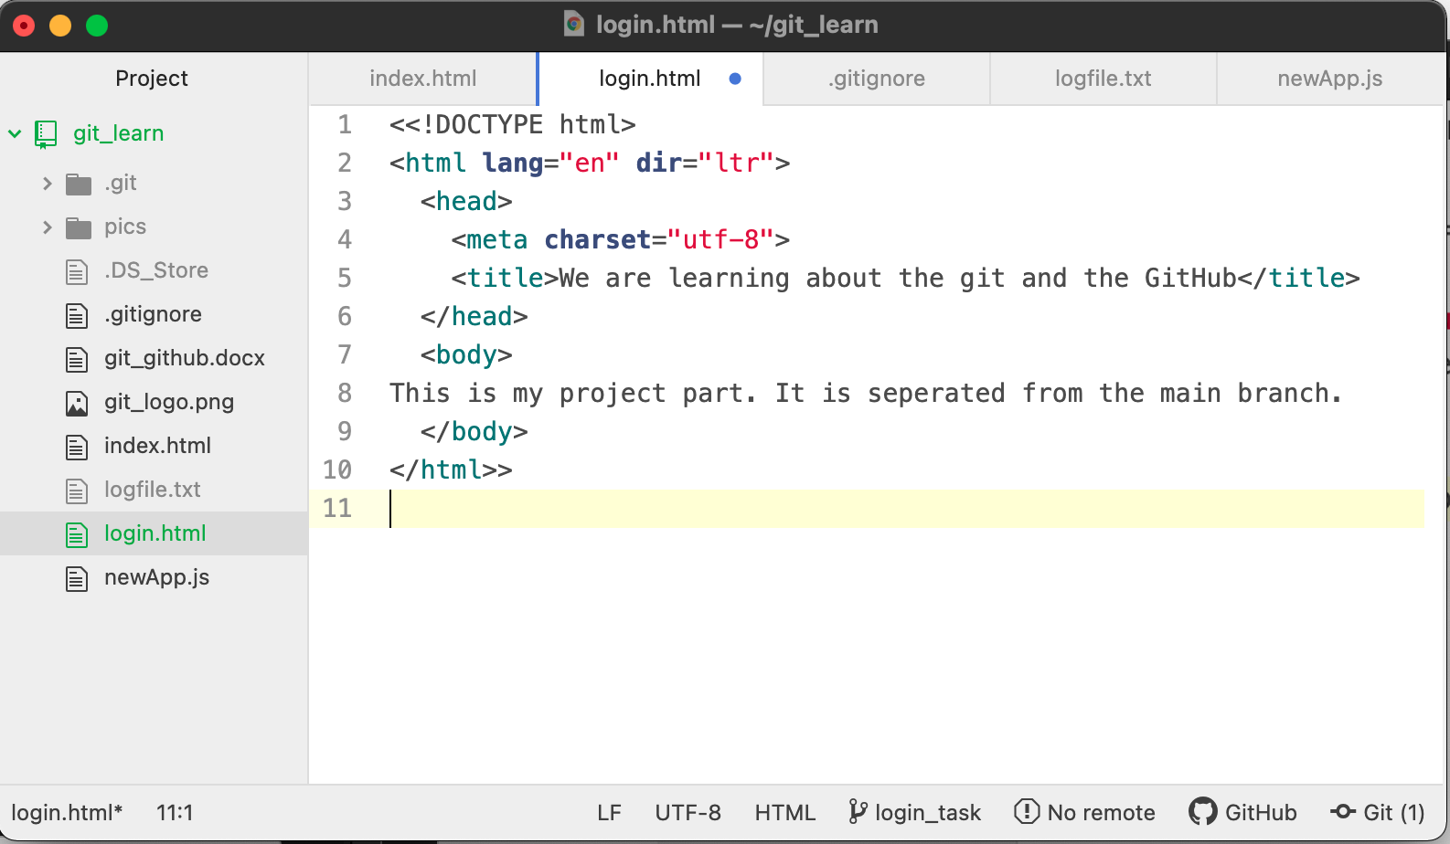

Slide 34
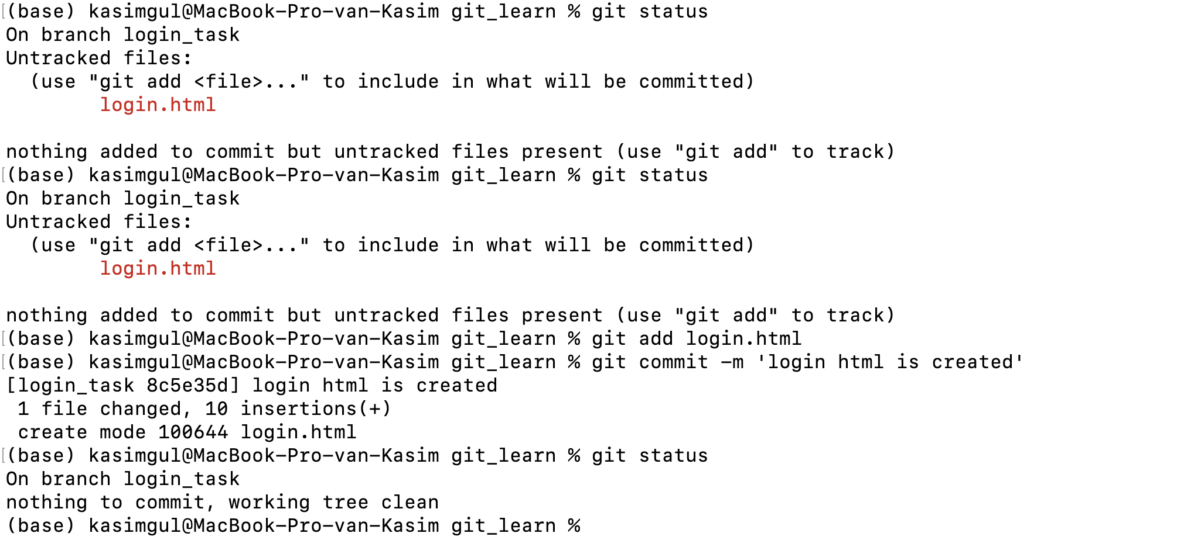
Get the repository information
Only the new file will be committed
Add the file to the staging area
Commit changes

Slide 35
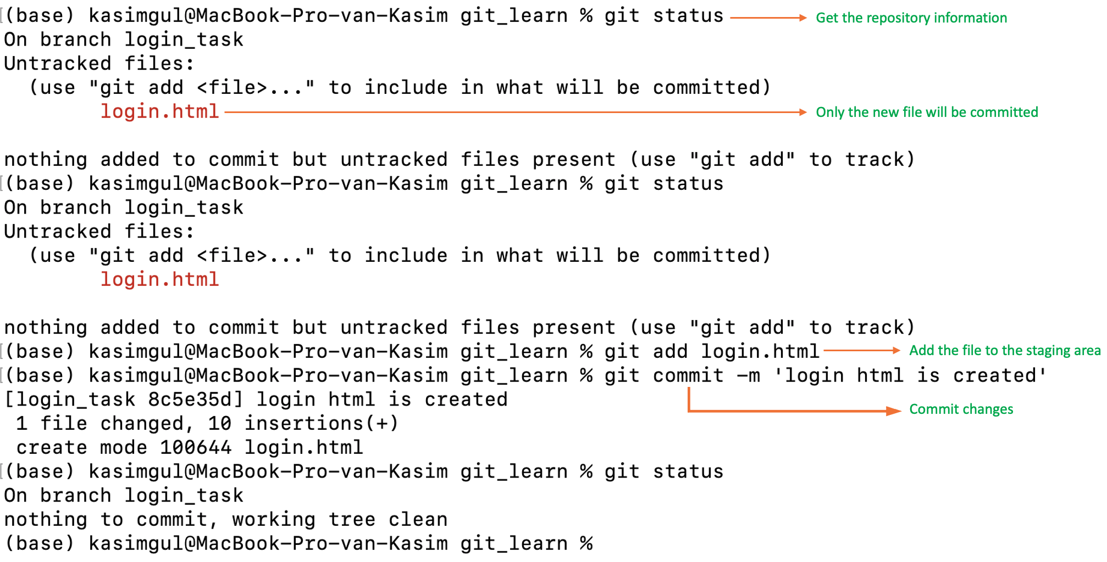

Slide 36
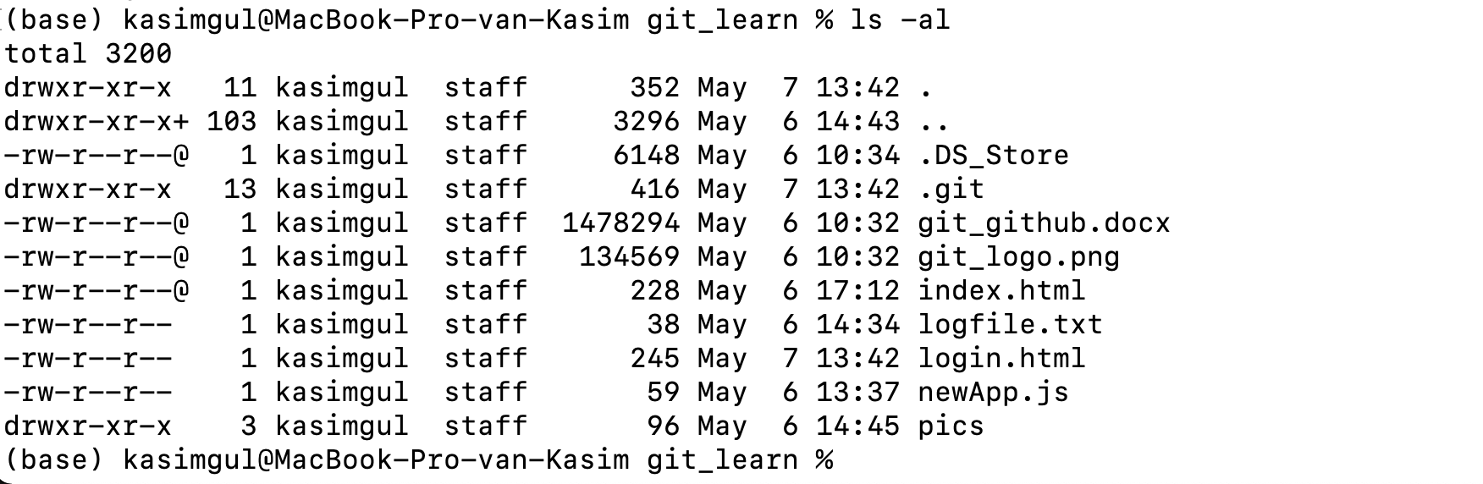


Slide 37


Switch to the “main” branch
login.html is not listed !

Slide 38


Merging two branches

Slide 39

Show the status of the repository branch
This file was created while we are in the “login_task” branch and it was not visible from the “main” branch before but now it is also listed.

Slide 40


Slide 41

Click me!

Slide 42


Slide 43


Slide 44

Give a name to your repository
Click to create your new repository

Slide 45


Slide 46

Your GitHub account name and the repository you are in
Remote repository URL
Explanations of how to use the Git with the GitHub

Slide 47


Slide 48
Setting the new remote repository URL as origin
Listing the existed remote repositories
git config -l | grep url
git remote rm origin
git remote add origin https://youngcoders2021@github.com/youngcoders2021/yCoders.git

Slide 49


Remote repository
The main branch
Uploaded files

Slide 50


Slide 51

Under the main branch
No README.md file yet
Click on to “Add a README” button.

Slide 52


Slide 53



Slide 54

Under the main branch
README.md is here!
It appears at the bottom
1 # used for bigger
2 # used
for smaller

Slide 55


Slide 56


Slide 57

Pulling (downloading) all committed remote repository files to our local repository
README.md is here!
Can you guess what are those +++++ signs for?

Slide 58


Slide 59


Slide 60

Create a new directory
List all with details
The new directory is created
Change Directory

Slide 61


Slide 62


Slide 63



Slide 64



Slide 65

New lines added!
“commit” below!

Slide 66


Slide 67


Slide 68


